Slide 1
Pritam Dandapat
Final Project
3/21/2024 Annual Review

Slide 2
Introduction
A keylogger, sometimes called a keystroke logger, is a type of surveillance technology used to monitor and record each keystroke on a specific device, such as a computer or smartphone.
It takes the information and sends to a hacker using command-and-control (C&C) server.
It can be either hardware or software based. Both types of keyloggers can be used for malicious purposes, including credential theft and identity theft.

Slide 3
KEY LOGGER AND SECURITY
Understanding And Mitigating Keylogging Threats
3/21/2024 Annual Review

Slide 4


AGENDA
Introduction
Problem Statement
Project Overview
End Users
Solution and Value Proposition
The "Wow" Factor in Our Solution
Modelling
Results
Conclusion and Q&A
3/21/2024 Annual Review

Slide 5

PROBLEM STATEMENT
Problem:
Keyloggers are a significant threat to cybersecurity,
leading to unauthorized access to sensitive information,
identity theft and financial fraud.
Impact:
Affects individuals, businesses, and organizations by
compromising data privacy and security.
3/21/2024 Annual Review

Slide 6

PROJECT OVERVIEW
Objective:
Develop a comprehensive understanding of keyloggers,
their types, how they work, and effective security measures to
prevent keylogging attacks.
Scope:
Includes an analysis of hardware and software keyloggers,
legal and ethical implications, security measures, and best practices.
3/21/2024 Annual Review

Slide 7

WHO ARE THE END USERS?
Individuals: Concerned about personal data security and privacy.
Businesses: Need to protect corporate data and ensure compliance with security standards.
Organizations: Require robust security measures to safeguard sensitive information.
Security Professionals: Aim to understand and mitigate keylogging threats.
3/21/2024 Annual Review

Slide 8

YOUR SOLUTION AND ITS VALUE PROPOSITION
To avoid keyloggers
Use anti virus program
Use password manager
Use multi factor authentication
Use a firewall
Avoid suspicious links and downloads
Change password periodically
Update your system
Use Virtual Keyboard to type passwords and sensitive information
3/21/2024 Annual Review

Slide 9
YOUR SOLUTION AND ITS VALUE PROPOSITION
Solution: Implement a multi-layered security strategy that includes
anti-keylogging software, regular system scans, software updates,
and user education.
Value Proposition:
Enhanced Security: Reduces the risk of data breaches and
identity theft.
User Awareness: Educates users about keylogging threats and
protection methods.
Compliance: Helps businesses and organizations comply with
data protection regulations.
3/21/2024 Annual Review

Slide 10

THE WOW IN YOUR SOLUTION
Innovative Approach: Combining technical measures with
user education for comprehensive protection.
Demonstration: Real-time demonstration of a simple keylogger
to illustrate the threat and the effectiveness of security measures.
Impact: Significant reduction in the likelihood of keylogging attacks
through proactive measures.
3/21/2024 Annual Review
10

Slide 11
MODELLING
Architecture Overview:
Modular Design: The keylogger code is structured into modular functions for better readability and maintenance.
Event Handling: Utilizes the pynput library to capture and handle keyboard events.
Data Logging: Implements functions to log captured data into text and JSON files.
3/21/2024 Annual Review
11

Slide 12
MODELLING
Components:
Key Press Handling: Function: on_press(key)
Description: Captures and logs the pressed keys.
Details: Appends key press events to a list and updates the JSON log file.
Key Release Handling: Function: on_release(key)
Description: Captures and logs the released keys.
Details: Appends key release events to a list, updates the JSON log file, and accumulates keys for the text log.
Logging Functions:
Text Logging: generate_text_log(key)
Description: Writes the recorded keys to key_log.txt.
JSON Logging: generate_json_file(keys_used)
Description: Dumps the list of key events to key_log.json.
3/21/2024 Annual Review
12

Slide 13
MODELLING
GUI Integration:
Tkinter Framework: Utilizes tkinter for creating a graphical user interface.
User Interaction:
Start Button: Initiates the keylogger.
Stop Button: Stops the keylogger.
Status Updates: Provides real-time feedback on the status
of the keylogger (running/stopped).
3/21/2024 Annual Review
13

Slide 14
MODELLING
Flow Diagram:
Initialization:
Set up the main GUI window.
Initialize global variables for key logging.
Event Capture:
Start capturing key events when the "Start" button is pressed.
Log key press and release events.
Data Logging:
Continuously update text and JSON log files with captured key events.
Stop Logging:
Stop capturing key events when the "Stop" button is pressed.
Update the GUI status to indicate the keylogger is stopped.
3/21/2024 Annual Review
14

Slide 15
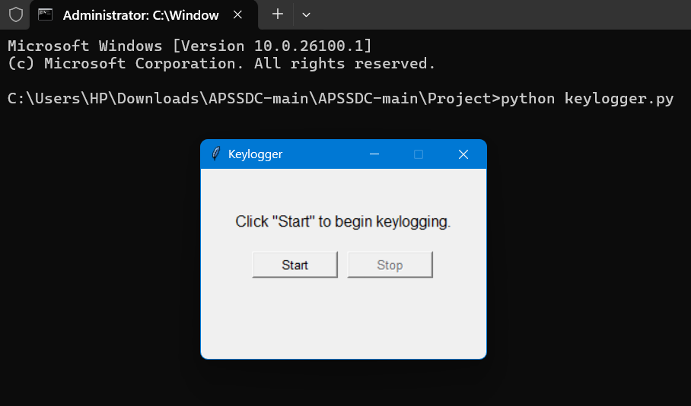
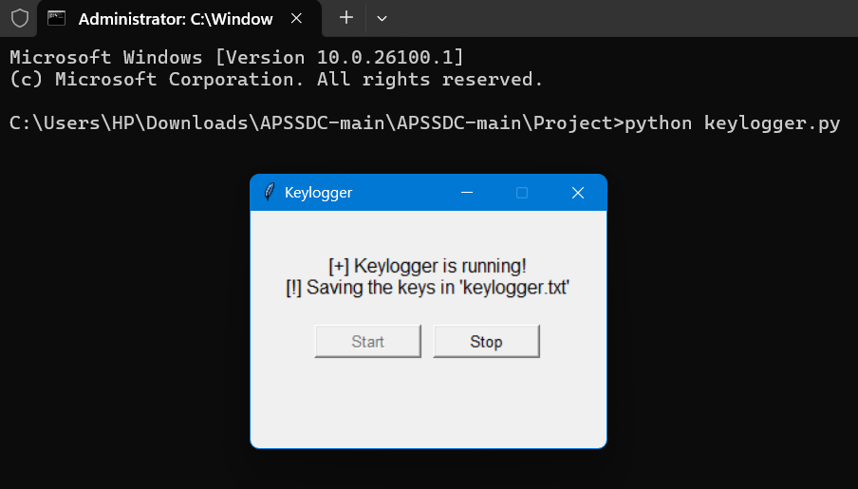
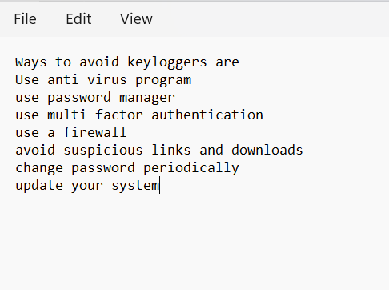
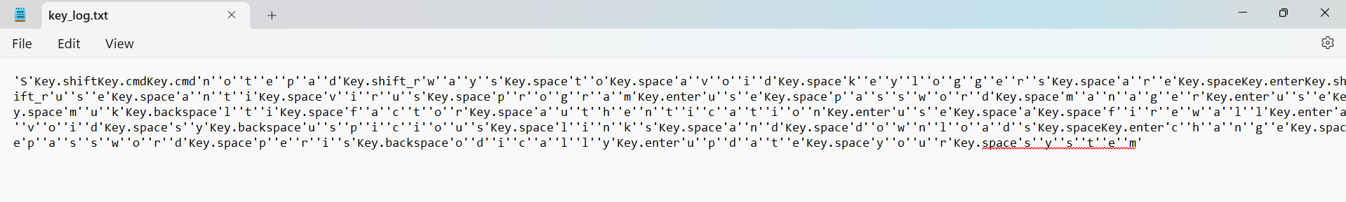
RESULTS
Screenshots of the GUI: Display the user interface, including the start and stop buttons, and the status label.
Sample Logs: Show examples of the key_log.txt and key_log.json files to illustrate how the keystrokes are recorded.
3/21/2024 Annual Review
15

Slide 16
RESULTS
Successfully implemented a keylogger that captures keystrokes and records
them into both text and JSON files.
Real-time keylogging with start and stop functionality controlled via a simple GUI.
The keylogger project demonstrated the capability to effectively capture and log keystrokes in real-time.
The GUI provided a user-friendly way to control the keylogger, making it accessible and easy to use.
Emphasized the ethical use of keyloggers and the importance of implementing security measures to protect against malicious use.
3/21/2024 Annual Review
16

Slide 17
PROJECT LINK- https://github.com/devilo0/Pritam__APSSDC-PROJECT-MAIN

